Slide 1
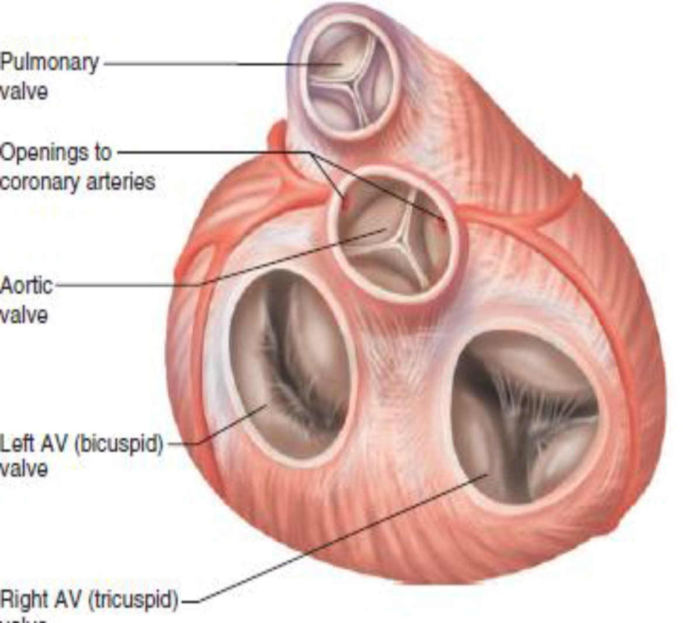
LECTURE NO (1)
Cardiovascular system (CVS) BADER HASSAN
Lecturer Of Physiology
Properties of the cardiac muscle
&
conductive system
Faculty Of Medicine Dept.Of Physiology

Slide 2
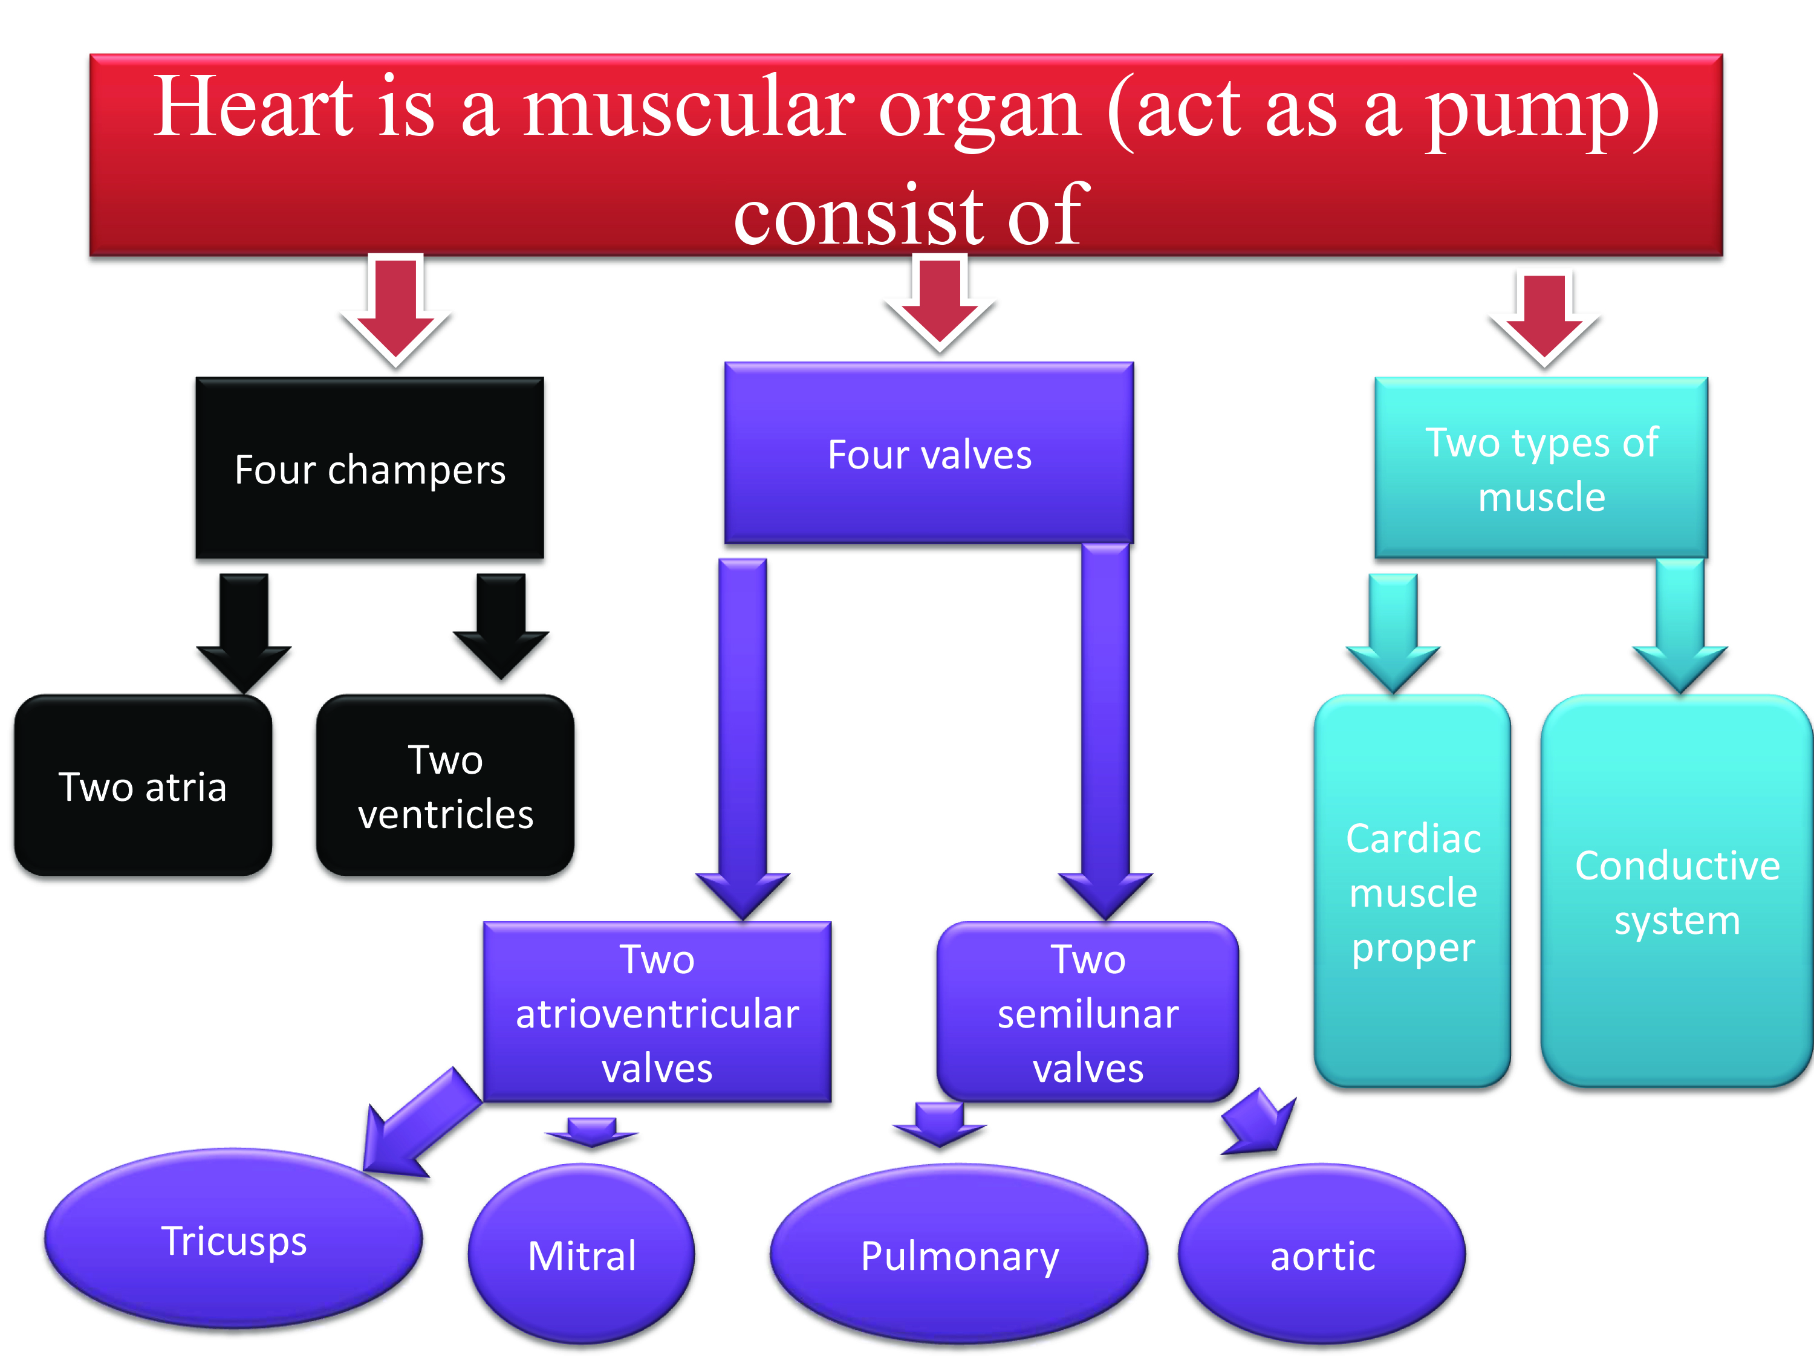

Slide 3
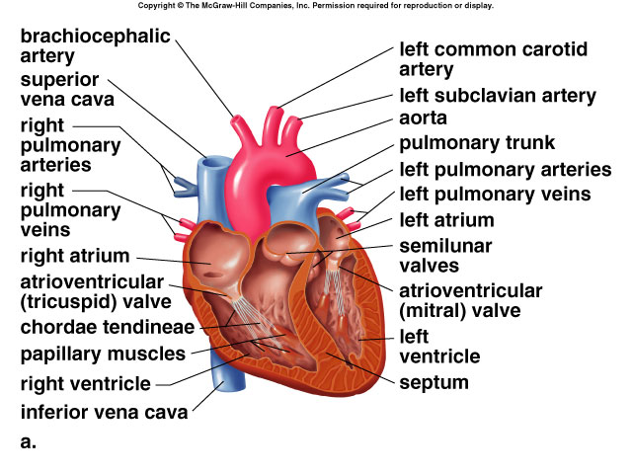

Slide 4


Slide 5
Cardiac muscle
The cardiac muscle contain tow types of muscle :
1- Cardiac muscle proper for contraction
2- Conductive system for generation and conduction of electrical signals (action potential)

Slide 6
Properties of the cardiac muscle
Excitability
Automaticity
Contractility
Relax-ability
Conductivity
Rhythmicity

Slide 7
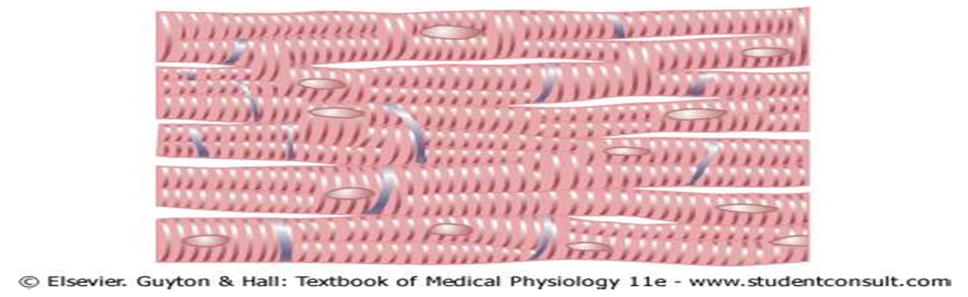
Properties of the cardiac muscle
1- Functional syncytium:-
Stimulation of one cardiac muscle cell result in stimulation of all the cells.
The heart contracts as one unit (syncytium).

Slide 8
2. The main source of energy:-
Fats
Fat = 60%
CHO = 35 %
Protein = 5%
3. Blood flow:-
Mainly during diastole not systole (specially the L V only during diastolic).

Slide 9
4. Metabolism:-
Depend exclusively on aerobic metabolism for generation of energy (99%), not anaerobic metabolism (1%) .
In sever hypoxia the anaerobic metabolism rise to 10 %

Slide 10
5. Rhythmicity:-
Ability of cardiac muscle to contract in regular form.
This is due to presence of the conductive system, which controls these rhythmic contractions.

Slide 11
6- Oxygen extraction:
The cardiac muscles (CM) extracts higher amount of O2 than skeletal muscle (70 – 80 % of oxygen delivered by blood).
7- Excitability :
Ability of the C M to generate action potential.
The action potential of C M characteristic by plateau phase.

Slide 12
Action potential of the cardiac muscle proper is characterized by the plateau phase (due to calcium influx), and that of the conductive system is characterized by the prepotential. Theses phases are not found in action potentials of other types of muscles

Slide 13
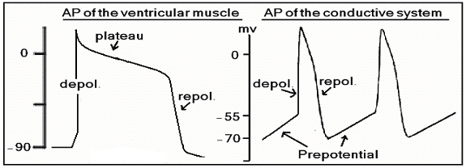

Slide 14
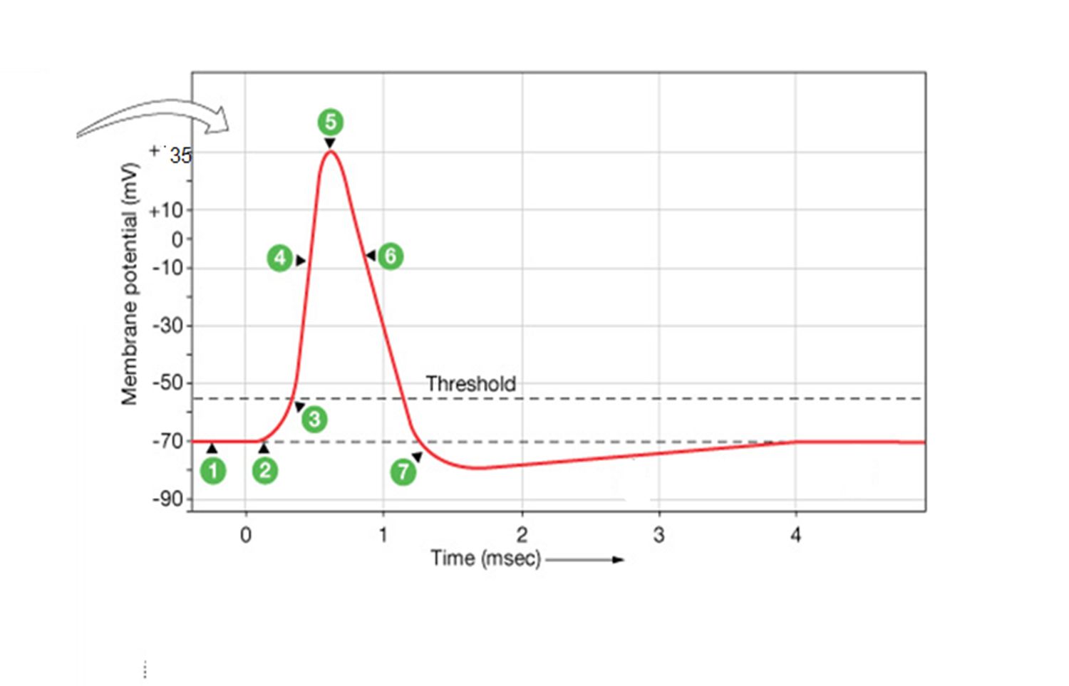

Slide 15
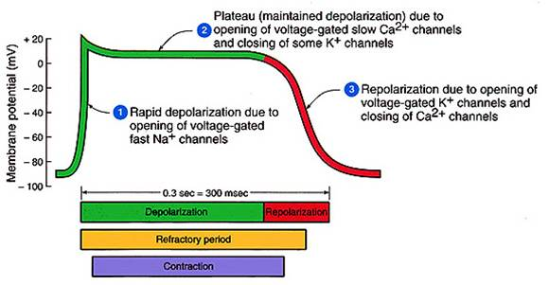

Slide 16
8- ECF Calcium:
CM depend on ECF & ICF Ca+2 in contraction .
Hypercalcemia increases contractility of the heart.
9- Conductivity :
Ability of CM to conduct impulses from point to anther point.

Slide 17
The conductive system
Formed of cardiac muscle fibers that are less striated and lack definitive boundaries.
Consists of following structure:-
Sino-atrial node (SA node):
Atrio-ventricular node (AV node):
Internodal atrial pathways.
Bundle of His.
2 budle branches: Rt & Lt.
Purkinje fibers.

Slide 18
Sino-atrial node (SA node):
Found in the Rt atrium, at the opening of the SVC
• Can discharge action potential spontaneously
Supplied by sympathetic and parasympathetic neurons. The sympathetic neurons increase the rate of discharge whereas the parasympathetic neurons decrease the rate of discharge.
• Rate of discharge
• without innervation = 100/min
• with innervation (symp & parasymp) = 70/min
• This indicates that the parasympathetic effect is more dominant than the sympathetic effect on the SA node.

Slide 19
The rate of discharge of the SA node is faster than other parts in the heart. So, the SA node determines the heart rate, for this reason it is regarded as the cardiac pacemaker.
Its action potential is characterized by the prepotential, which is due to decreased K efflux. Depolarization is due to calcium influx.

Slide 20
Atrio-ventricular node (AV node):
Found in the Rt atrium on the right side of interatrial septum, above the fibrous ring.
Delays conduction from atria to ventricles (Its muscle fibers have lower number of gap junctions and less diameter than the SA node).
This allows atrial contraction to precede ventricular contraction and therefore completes ventricular filling.

Slide 21
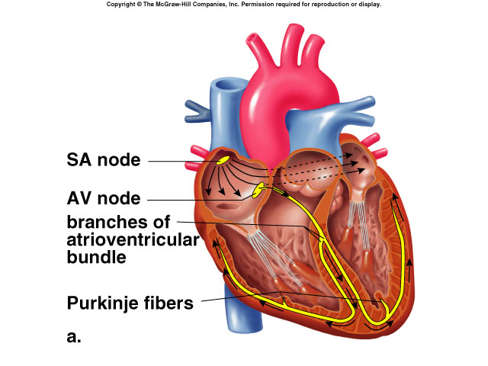

Slide 22
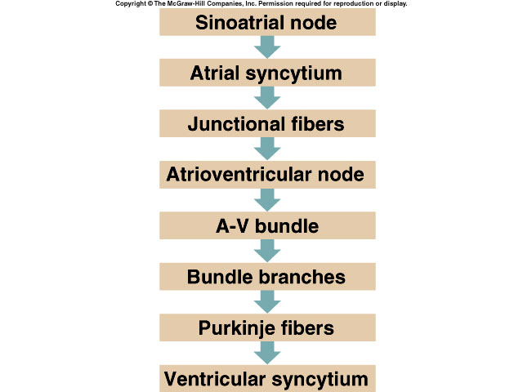
Cardiac Conduction System

